Slide 1
Welcome to the 2019-20 AP® School Year
At Neenah High

Slide 2
Three Changes are Coming to AP in 2019-20
AP teachers will have access to year-round, new instructional resources that measure student progress. These resources will help students master the content and skills needed for success in the course and on the exam.
New streamlined registration and ordering system gives time back to AP Coordinators.
Exam ordering is moving from spring to fall.

Slide 3
Why Shift Exam Ordering
from the Spring to Fall?
3

Slide 4
AP® students do college-level work in high school. If they score a 3 or higher on the exam, they can earn college credit. However, not all AP students pursue the credit they deserve.
So what stands in their way?
4

Slide 5
Nearly all students start the year with high expectations for themselves...
Fall: Percentage intending to take the AP Exam
Spring: Percentage who actually took the AP Exam
96%
93%
75%
58%
White Male
African American Female
White Male
African American Female
...but confidence erodes over the course of the year.
5
Of all groups surveyed, White Males lost the least amount of confidence, while African American Females lost the most confidence.

Slide 6
A commitment to success.
Fall exam registration is a best practice at more than half of AP schools. In the 2017-18 school year, the College Board piloted earlier registration with 40,000 students.
They saw an increase in scores of 3 or higher across multiple groups. Moving the time of registration made a difference across the board, but it had the strongest effect for students who are traditionally underrepresented in AP.

Slide 7
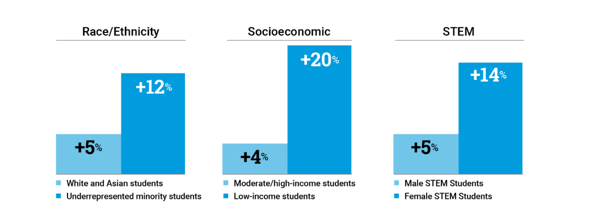
Fall Registration
Scores of 3+ increased across student groups

Slide 8
Fall Registration
“Fall registration has been a great way to build a culture in AP where everyone was on board and we used the year to prepare for the exam at the end of the year, it was more of an all hands on deck type of mentality. There was an expectation, a common goal of passing the AP test that we were all working together to accomplish throughout the school year. I think this allowed for my students to grow in their confidence, confidence which they may not have otherwise had.”
— Meg Shadid, AP World History and AP Economics teacher

Slide 9
Supporting student success
Students are more likely to stay engaged in class and tackle challenging topics head-on when they register in the fall. Fees for late registration and exam cancellation ensure that students don't wait until the last minute to make a decision. This has helped teachers create a classroom culture where students are “all in.”
During the College Board’s pilot, few students registered late or canceled their exams.

Slide 10
Fall Registration
AP Exam Fees for 2019-20: The base exam fee is not changing
Description Cost/Exam
Fall registration | Exam ordered by Nov. 15 | $94
Late registration | Ordered Nov. 16–Mar 13 | $94 + $40 fee
Unused/ canceled exam | Exam that is canceled or not taken by the student | $40 fee
What’s new? There will be a $40 fee for late exam registrations and unused or canceled exams.

Slide 11
Fall Registration
AP Exam Fees for 2019-20: The base exam fee is not changing.
Also not changing is our policy of supporting low income students. Although we will require a $40/exam ordering fee in the fall, all payments from students who qualify for free/reduced lunch will be refunded at the end of the year, providing students complete the exams for which they registered.
Why charge an ordering fee? We must pay $40 for each unused exam.

Slide 12
To support year-long engagement, the College Board is providing new resources for students, teachers, and coordinators.
These resources were designed and tested by AP teachers and coordinators to provide focused content, greater efficiency, and more flexibility.

Slide 13
A few clicks unlock the new tools and resources.
AP educators and students sign in and activate the new AP Classroom system at the start of the school year.
Digital activation will:
Give students and teachers access to the new resources throughout the school year
Allow teachers to organize their AP students by the sections they teach
Allow students to register for exams
13

Slide 14
Built to provide transparency and help students succeed. New instructional resources provide teachers with real-time feedback on student progress in the development of knowledge and skills essential for college.

Slide 15
Personal
Progress Checks
Personal progress checks provide students with actionable feedback throughout the year.
The personal progress checks measure progress and skills through:
Multiple-choice questions with rationales to explain correct and incorrect answers
Free response questions with AP scoring guidelines teachers can use to evaluate student work

Slide 16
Progress
Dashboard
A progress dashboard highlights progress and areas of focus throughout the year.
Interactive reports:
Educators can use the progress dashboard to pinpoint students’ strengths and weaknesses on AP content and skills to improve performance
Students can also use the tool to monitor their own progress

Slide 17
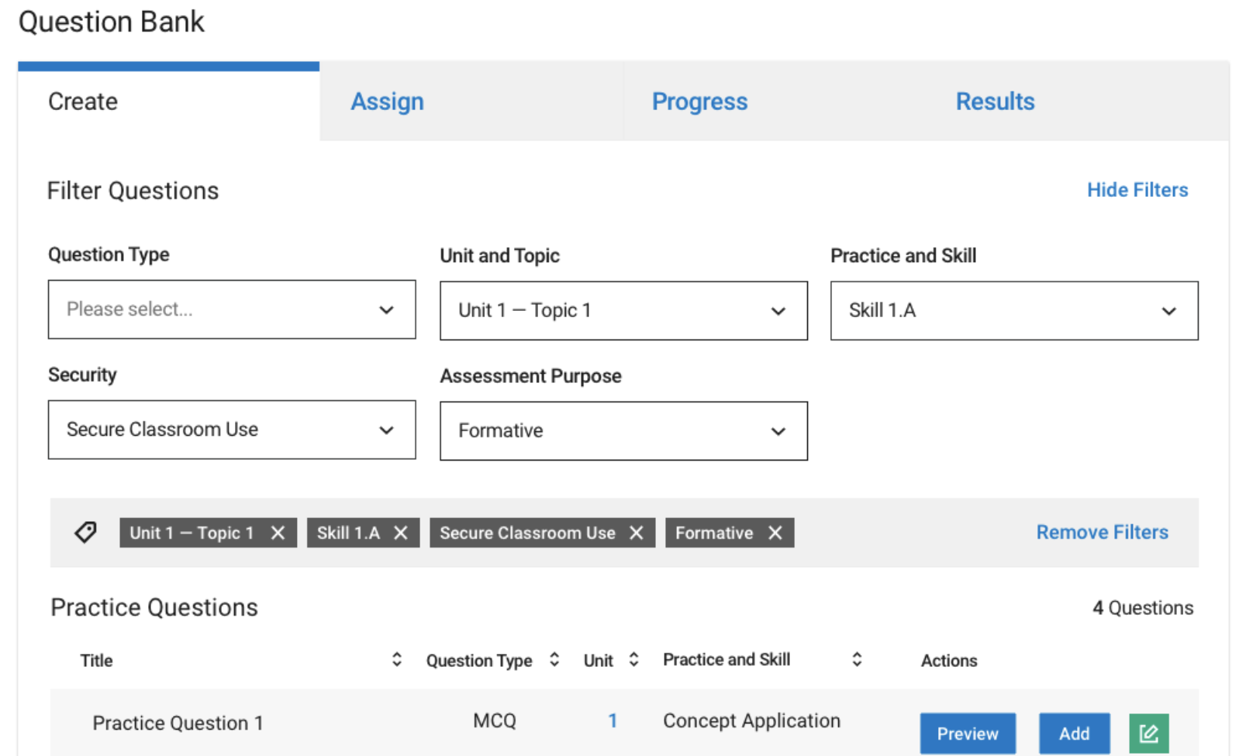
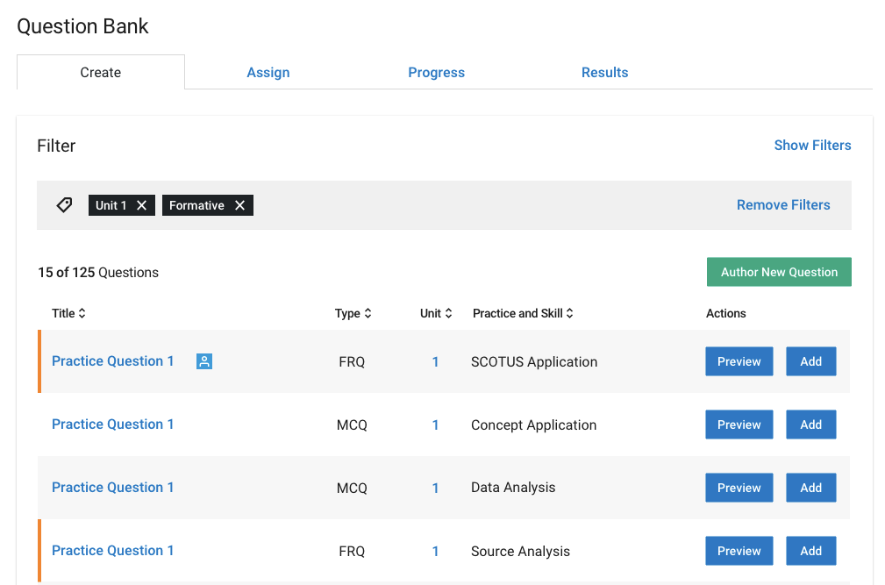
AP Question
Bank
Question bank boosts exam practice with 15,000+ on-demand AP Exam questions.
A library of real AP Exam questions that teachers can access. The bank:
Can be filtered by course topics and skills
Can be used to create customized practice and tests that can be assigned online or on paper as in-class assignments or homework
Enables teachers to create their own questions or edit existing questions

Slide 18
AP Students
Charting a Path to College Credit
Personalized feedback: Students will get personalized feedback through new digital tools that provide daily support for every AP classroom.
Insights on strengths and areas for growth: With the personal progress checks, teachers can identify content and skill areas where students are struggling and use the Question Bank to provide them with targeted practice opportunities.
Exam day improvements: For the first time, schools will receive personalized registration labels for each student taking an AP Exam. Students won’t need to bubble in their personal information – reducing time and stress on exam day.

Slide 19
Next steps for students
Before the 2019-20 School Year
Spring 2019: Students sign up for AP classes at school
Students visit apstudent.collegeboard.org to learn more about AP courses and exams.
Students without a College Board account should create one and set their password. Students will need their username and password in the fall.
During the 2019-20 School Year
First week of class: Teachers will give students a join code for each of their AP classes. Students use their College Board username and password and join code to enroll in their class section.
Students will automatically be registered for exams unless they complete and return the “opt-out” form by September 16. All AP teachers have opt-out forms available.
Sept. 30-Oct. 14: Students pay for exams.
March: Schools submit any changes to exam registration and students complete exam registration for spring courses.
19

Slide 20
Thank you

